Slide 1
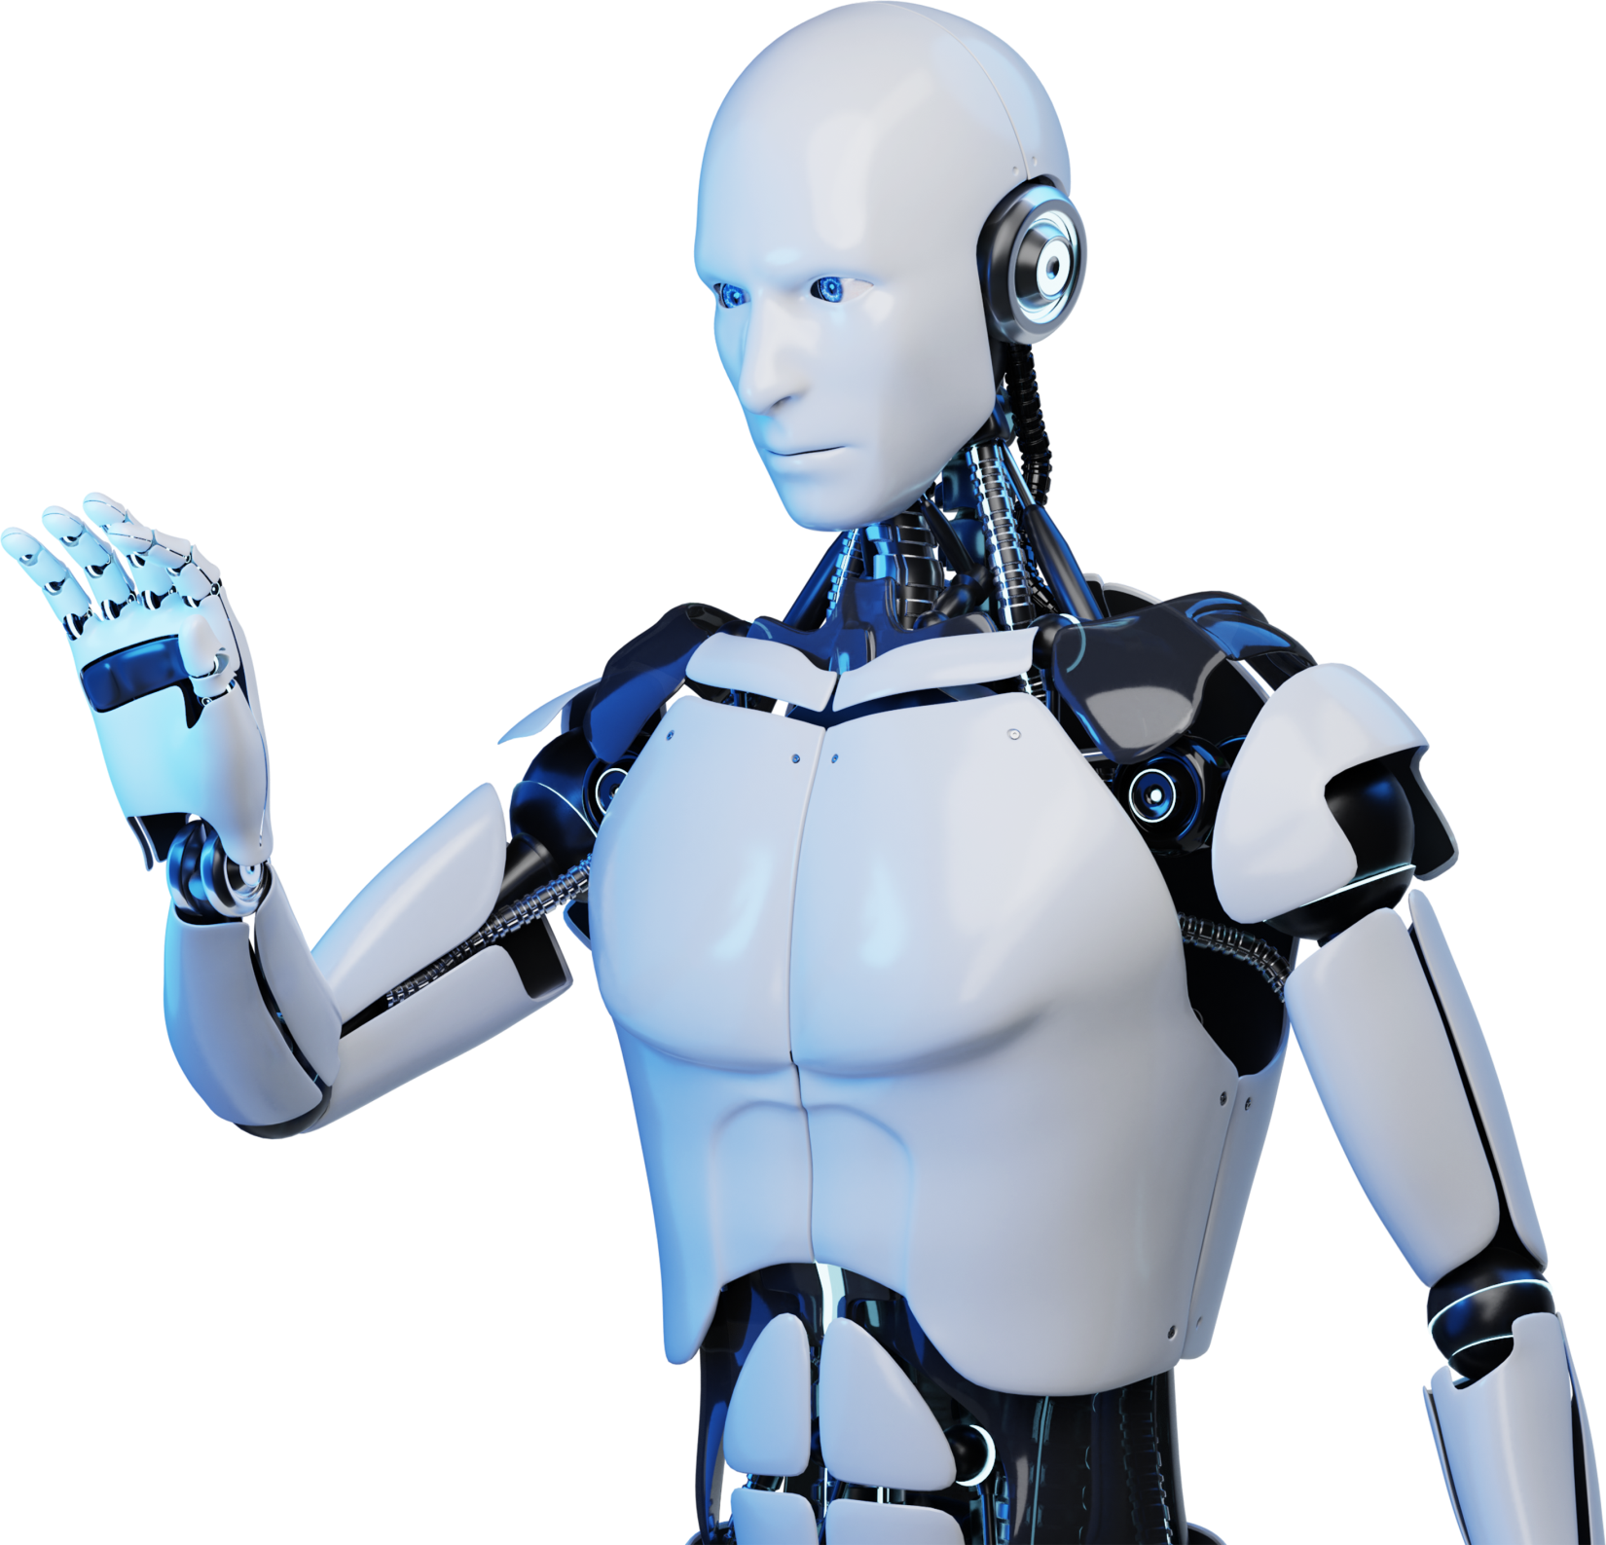
Conversational Bots: ChatBots
G.Dilli Sireesha (192210552) Yuvasree

Slide 2


Table Of Contents:
01. Introduction of Chatbots
02. Objective
03. Abstract
04. Algorithm and Architecture
05. Screenshot
06. Conclusion of Chatbots
07. References

Slide 3
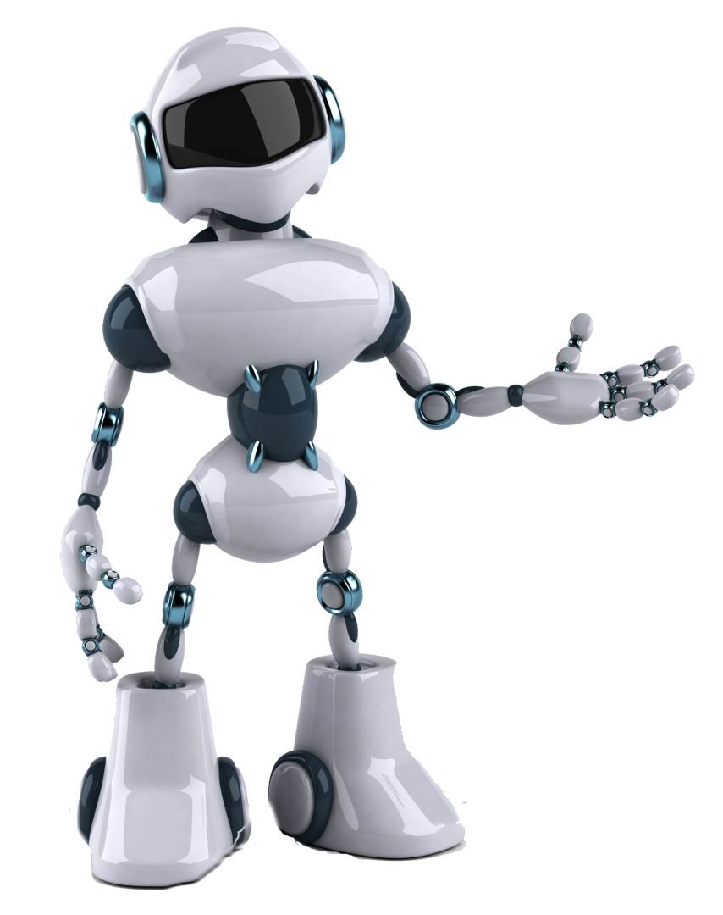
Introduction
Conversational bots, or chatbots, are AI-powered tools designed to simulate human conversation using natural language processing (NLP).
They offer 24/7 availability, automating routine tasks and providing instant support across various domains like customer service, healthcare, and education.
Chatbots can handle multiple interactions simultaneously, making them highly scalable solutions.
They also deliver personalized experiences by utilizing user data and interaction history.
As technology advances, chatbots are becoming increasingly sophisticated, offering more complex and valuable services.

Slide 4
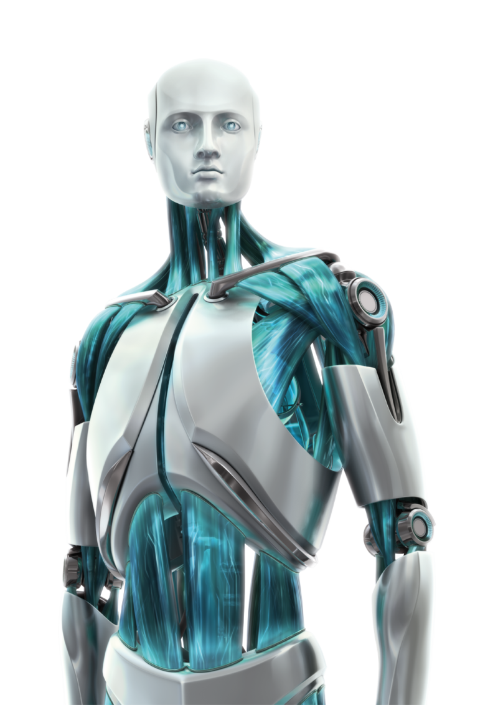
Objectives:
Enhance User Experience: Provide instant, accurate, and personalized responses to user queries, ensuring a seamless interaction.
Automate Routine Tasks: Streamline processes such as scheduling, reminders, and basic information retrieval to improve efficiency.
Improve Availability: Offer 24/7 support to ensure users can access assistance at any time, without delays.

Slide 5

Advantages In Customer Service
Chatbots in customer service offer 24/7 availability, quick response times, personalized interactions, and efficient issue resolution.

Slide 6

Enhancing
User Experience
Provide instant, accurate, and personalized responses to user queries, ensuring a seamless interaction.

Slide 7
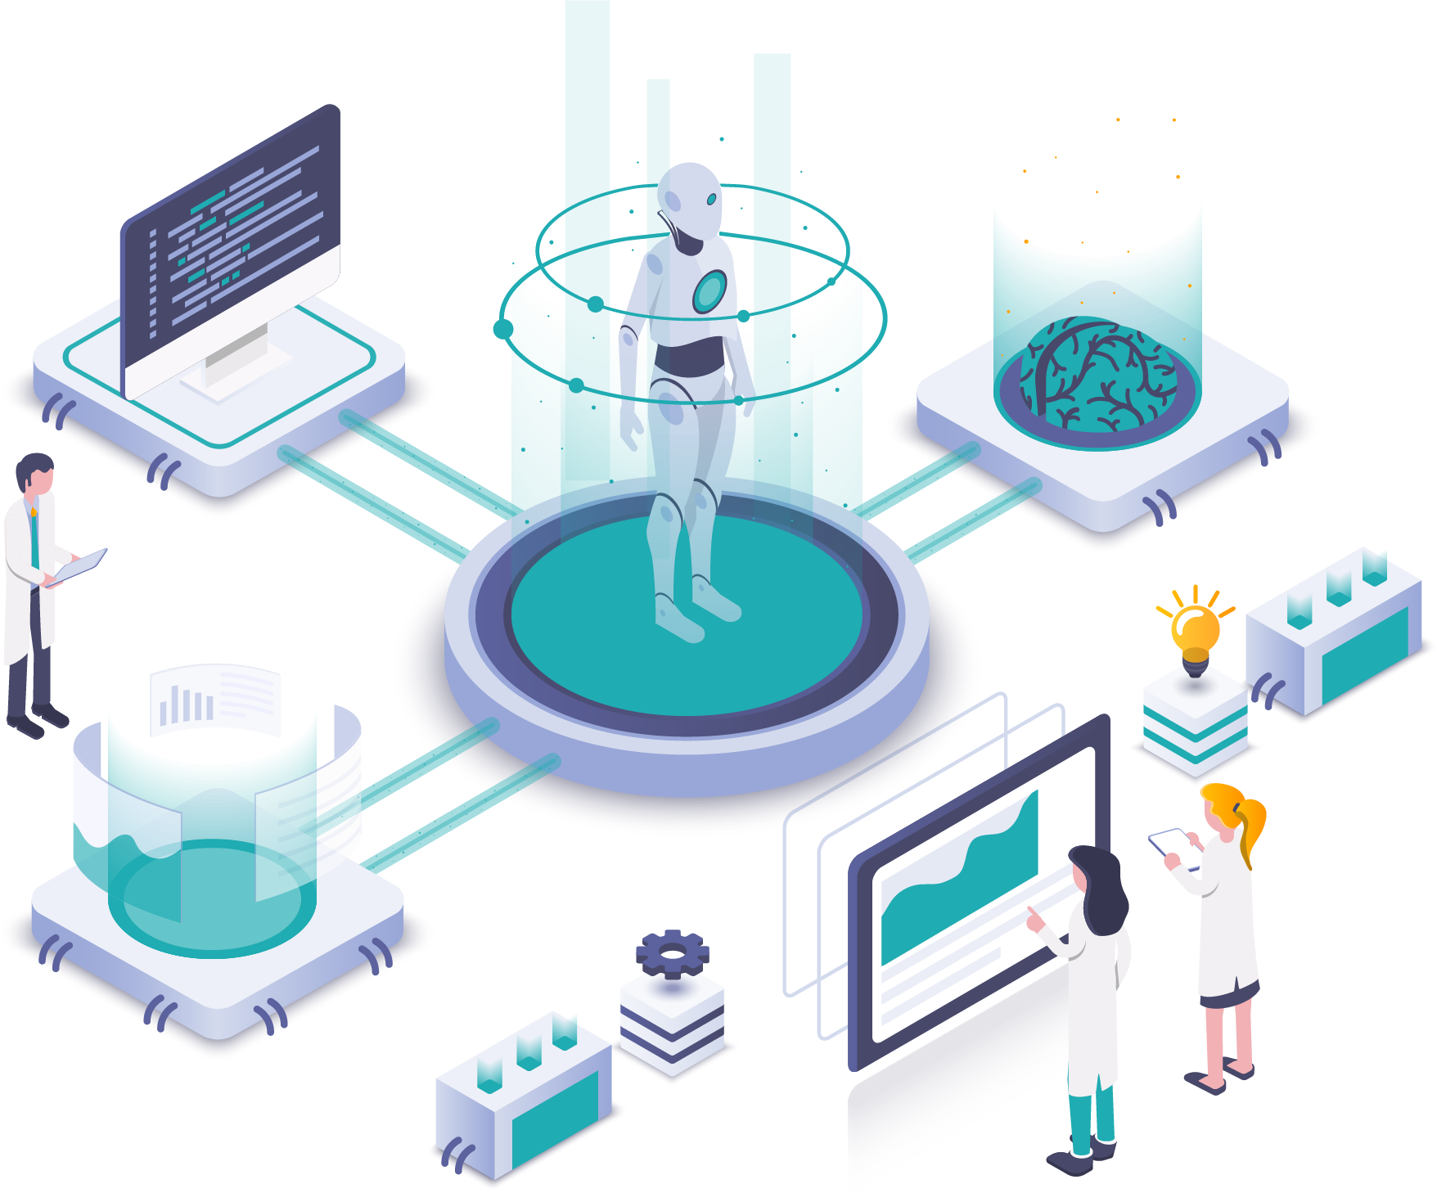
Role Of NLP
NLP enables chatbots to understand and interpret user inputs accurately, ensuring meaningful interactions by maintaining context, handling language variations, and generating appropriate responses. Additionally, NLP allows chatbots to perform sentiment analysis, enhancing their ability to provide empathetic and relevant replies.

Slide 8

Lead Generation And Conversion
Chatbots engage visitors, qualify leads, and collect contact information, streamlining the lead generation process. They also provide personalized recommendations and automate follow-up messages to nurture leads towards conversion.

Slide 9
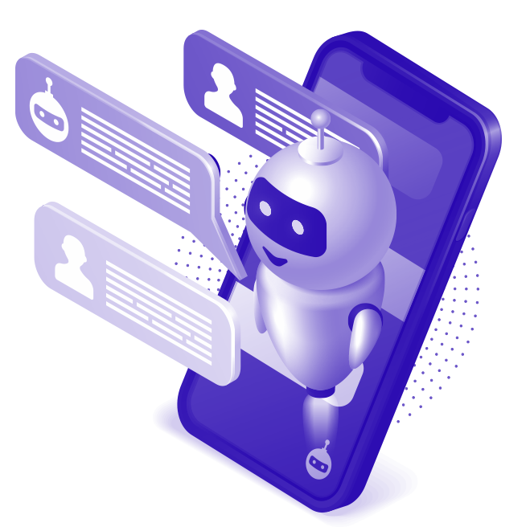
Chatbots In Virtual Assistants
Chatbots in virtual assistants like Siri, Google Assistant, and Alexa enhance user interactions by providing instant information retrieval, managing tasks like setting reminders, and controlling smart home devices through natural language processing and AI capabilities.

Slide 10

Future Trends In Technology
Future trends in chatbot technology include enhanced natural language processing for nuanced conversations and integration with AI for hyper-personalization and multi-modal interactions, shaping a landscape where chatbots become more integral to daily tasks and customer interactions.

Slide 11
Design Principles For Interactions
1
Clarity and Simplicity
6
Progressive Disclosure
2
Natural Language Understanding (NLU)
7
Error Handling
3
Personalization
8
Multi-Modality
4
Context Awareness
9
Human-like Personality
5
Feedback and Confirmation
10
Testing and Iteration

Slide 12
Chatbots For Social Media
Chatbots play a crucial role in enhancing user engagement and customer service on social media platforms. Here are some specific ways chatbots are utilized effectively on social media
Customer Support
Event Management
Lead Generation
Feedback Collection
Content Distribution
Surveys and Polls
E-commerce Transactions
Social Media Advertising

Slide 13
Abstract:
01. Chatbots leverage natural language processing and AI to revolutionize user interactions, particularly on social media platforms.
02. They enhance customer support, automate lead generation, distribute content, and streamline e-commerce transactions.
03. By adhering to design principles like personalization and robust error handling, chatbots improve efficiency and engagement.
04. This abstract highlights their transformative potential and essential role in modern digital communication.

Slide 14

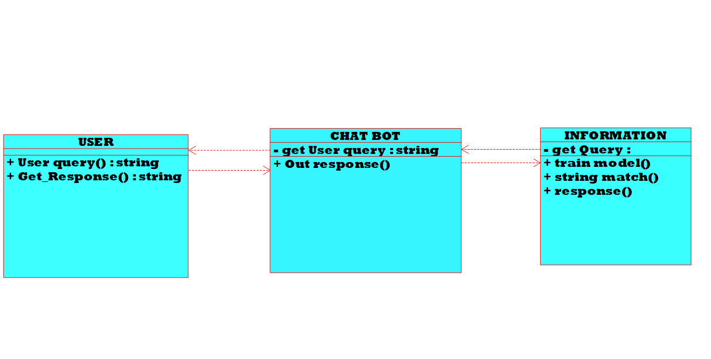
Class Diagram

Slide 15
Understanding Complex Queries
Limited Scope
Personalization Limitations
Error Handling
Integration Challenges
Challenges and limitations
Security and Privacy Concerns
Maintenance and Updates
User Acceptance

Slide 16
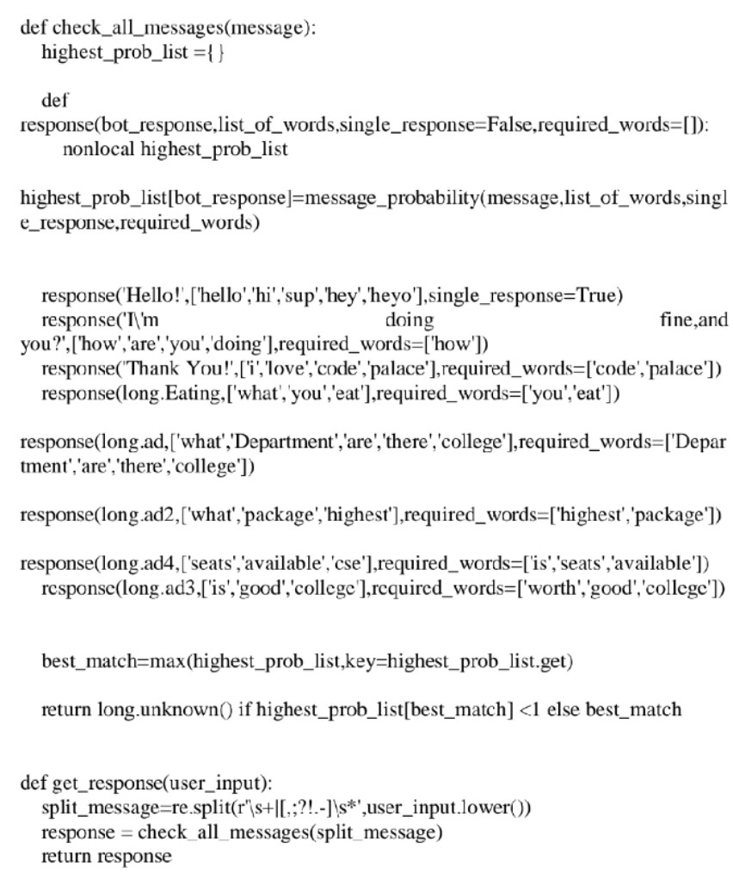
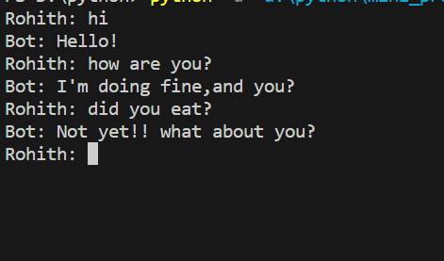
Execution and Algorithm:

Slide 17

Conclusion
Chatbots offer significant benefits in enhancing digital interactions and customer engagement but must overcome challenges like complex query handling and data security. With ongoing advancements, they are set to play a crucial role in the future of digital communication.

Slide 18

References:
Shevat, A. (2017). Designing Bots: Creating Conversational Experiences. O'Reilly Media. This book provides comprehensive guidance on designing user-friendly and effective chatbots.
Levitin, V. (2019). Chatbots: 101 Tips and Tricks to Create a Successful Chatbot. Independently published. This guide offers practical advice for developing and deploying successful chatbots.
Følstad, A., Brandtzaeg, P. B. (2017). "Chatbots and the New World of HCI." Interactions, 24(4), 38-42. This paper explores the human-computer interaction aspects of chatbots and their usability challenges.
ThinkPalm Technologies. (2020). The Chatbot Revolution: Benefits and Business Opportunities. Available at: ThinkPalm. This article discusses the business advantages and opportunities presented by chatbots.

Slide 19


